Slide 1
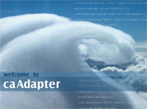




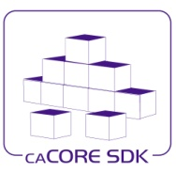


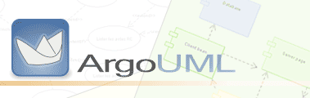

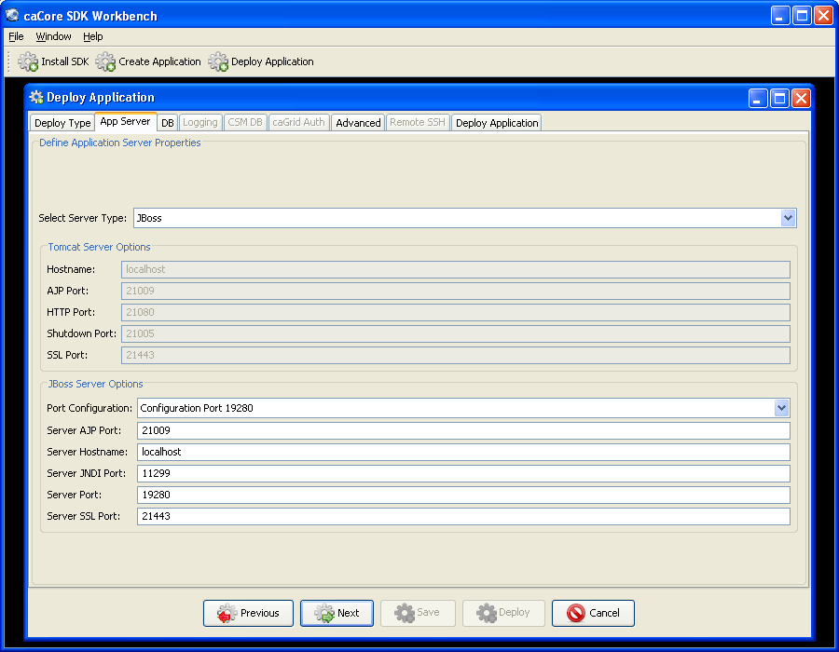
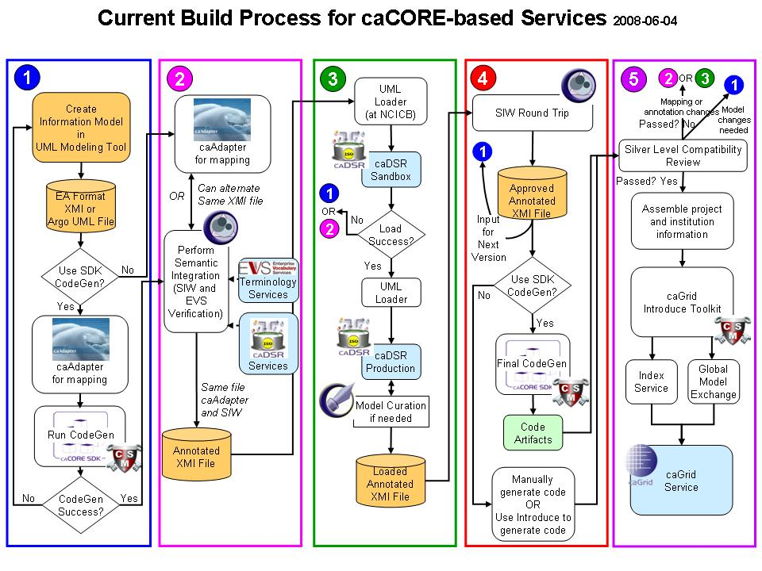
caCORE Workbench –
Application Development Environment
Dan Dumitru, Santhosh Garmilla, Satish Patel - Ekagra Software Technologies
Aynur Abdurazik , Xiaoling Chen - SAIC
David Hau, Sichen Liu, Avinash Shanbhag, Denise Warzel - NCI CBIIT
Ekagra
Overview
The caCORE Workbench is an integrated platform that allows users to generate a caBIG® silver or gold compliant system from a simple GUI. Using this workbench, the user can create a new data service application by specifying the UML model and the system generation settings. The Workbench saves time and reduces human error in generating a semantically integrated “caCORE-like” system.
caCORE Workbench – Application Development Environment
UML Model
Current caCORE Development Process
UML Model
Model Mapping
Register Model
Semantic Integration
Security Configuration Tool
(UPT)
Configure/Deploy
Generate
SDK Client API
(Silver Compatible)
Log Viewer (LLT)
Configure/Deploy
Generate
caGrid Client API
(Gold Compatible)
caCORE Workbench
Benefits of the caCORE Workbench
Reduces the learning curve for the individual tools and workflows between the tools
Provides a single tool to manage all the steps to create an application
Enhances the user experience and encourages participation from the user community in the caBIG® program
Allows rapid evaluation of tools and technologies offered in the caBIG® program
Improves productivity of the developers by reducing the development cycle and the cost
Limitations of the Current caCORE Process
Steep learning curve for the process in addition to the individual tools
An array of tools to generate a single application in the caBIG® program
A set of documentation needed to be studied to learn application development process
Errors encountered in the later stages of the process requires repetition of prior stages
Implementation Plan
Phase I: In progress
  Establish the foundation of the workbench
  Enable individual tools to use the workbench and implement their workflow
Phase II: Future
  Integrate existing tools and their workflows in the workbench
  Maintain boundaries between individual tools in the workbench
  Implement additional workflows to manage the application development process
Phase III: Future
  Harmonize the workflows between the individual tools
  Eliminate boundaries between the tools to provide an unified view
Further Information
SDK Website: https://cabig.nci.nih.gov/tools/caCORE_SDK
SDK Users Mailing List: CACORE_SDK_USERS-l@list.nih.gov

